Slide 1
STATISTICAL ANALYSIS & INFERENCE
(in a nutshell)
Vinh Q Tran
Massachusetts Institute of Technology (MIT)

Slide 2
Distributions

Slide 3
Basis of Probability

Slide 4
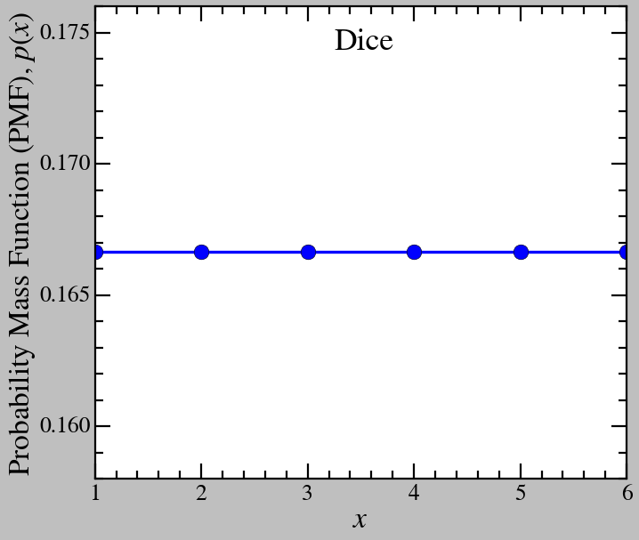
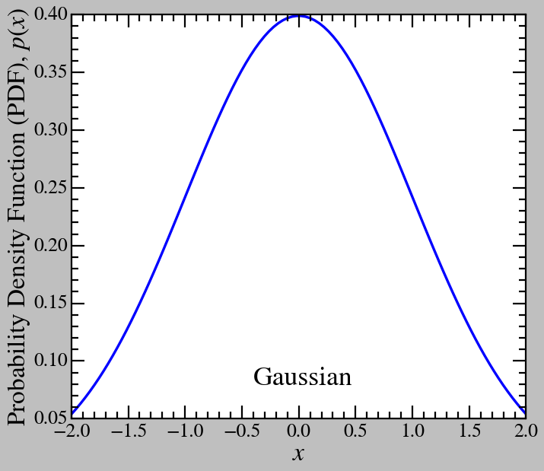

What is a Distribution?
Random variable ($x$): outcome (or possible outcome) of something, e.g. measurement (length of string, mass of particle,..), number on dice, …
Discrete v.s. continuous random variable.
Distribution: describe how the possible values of the random variable spread/cluster, i.e. how they “distributed”, their probability.
Distributions can be calculated from samples of random variables ($\left\{x\right\})$, i.e. values of measurements.

Slide 5
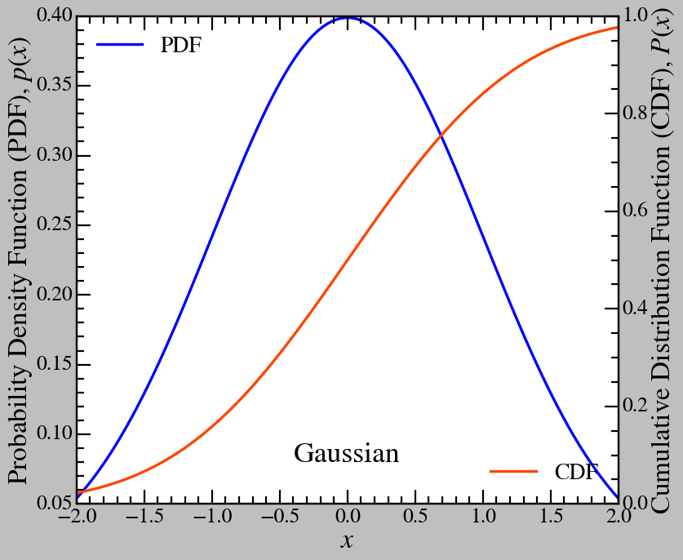
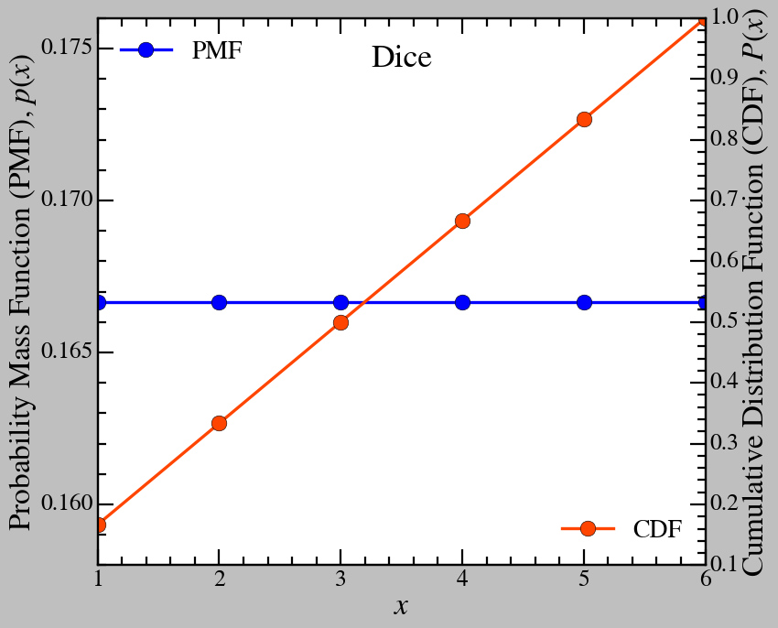

PDF (PMF), CDF
PDF (PMF): probability distribution (mass) function, $p(x)$, describes how the possible values of the random variable, $x$, are distributed (main description of the distribution).
CDF: cumulative distribution function, $P(x)$, describes the probability of the random variable having values less or equal than $x$. Enforcing $P\left(∞\right)=1$ is called normalizing the PDF/PMF.

Slide 6


Mean, Variance, Standard Deviation, Median, and Mean Absolute Deviation
Mean:
Sample: $\overline{x}=\frac{\sum{x}}{N}$
Distribution: $\left\langle x\right\rangle =\sum{p\left(x\right).x= \int{p\left(x\right).x.dx}}$
Variance:
Sample: $s^{2}=\frac{\sum{{\left(x−\overline{x}\right)}^{2}}}{N−1}$
Distribution: $σ^{2}=\left\langle {\left(x−\left\langle x\right\rangle \right)}^{2}\right\rangle$
Standard Deviation (std)
Sample: $s= \sqrt{s^{2}}$
Distribution: $σ= \sqrt{σ^{2}}$
Median: $med(x)$, the ”middle” value of the sample or the value x at which $P(x) = 0.5$.
Median Absolute Deviation (mad): $med\left(\left|x−med\left(x\right)\right|\right)$.
Med and mad ($mad=0.67449 std$ assuming gaussian) show the spread of the distribution (or sample) with lesser effect from outliers when compared to mean and std.

Slide 7
Common Distributions

Slide 8
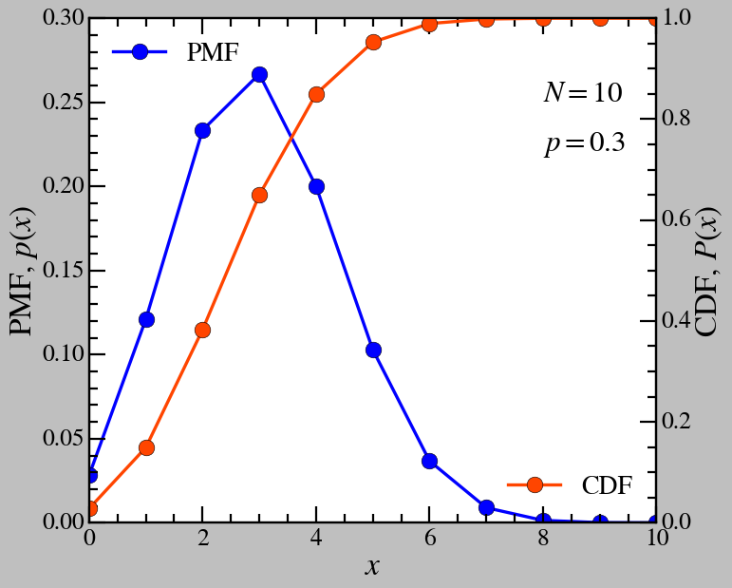

Binomial
Having $N$ numbers, each has the probability of $p$ of being A and $1−p$ of being B, what is the probability that $n$ numbers out of $N$ is A?
$$p\left(n\right)= \left({N \atop n}\right)p^{n}{\left(1−p\right)}^{N−n}=\frac{N!}{n!\left(N−n\right)!}p^{n}{\left(1−p\right)}^{N−n}$$
$\left\langle n\right\rangle =Np$
$σ^{2}=N\left(1−p\right)p$

Slide 9
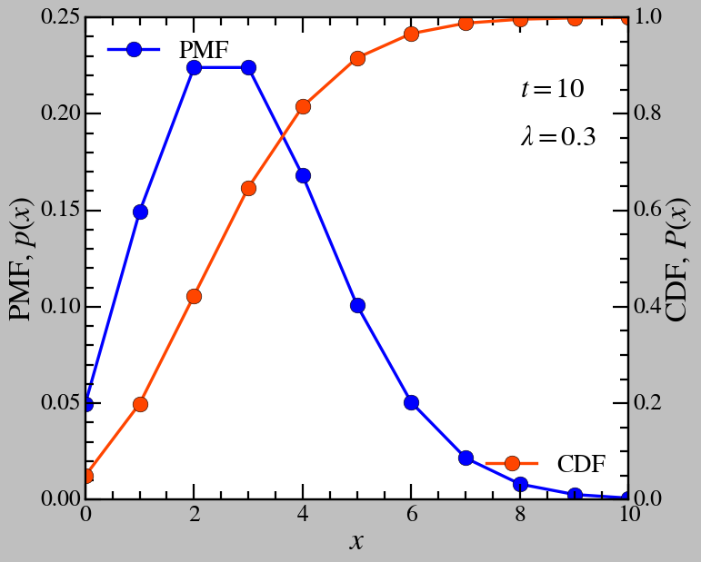

Poisson
Given the constant mean rate of probability that an event occurring $λ$ and the time interval $t$, what is the probability that $n$ events happen?
$$p\left(n\right)=\frac{{\left(λt\right)}^{n}e^{−n}}{n!}$$
$\left\langle n\right\rangle =λt$
$σ^{2}=λt$
(!) The binomial distribution become the Poisson distribution when $n→∞, p→0$.

Slide 10
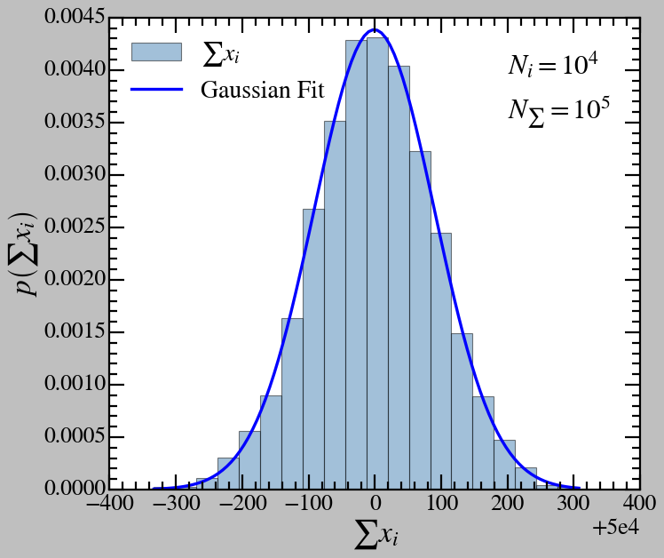


Gaussian
The “normal” distribution
$$p\left(x\right)=\frac{1}{\sqrt{2πσ^{2}}}e^{−\frac{{\left(x−μ\right)}^{2}}{2σ^{2}}}$$
$\left\langle x\right\rangle =μ$
$σ^{2}=σ^{2}$
(!) The gaussian distribution becomes the Poisson distribution when $μ=σ^{2}$ and $λ→∞$.
(!) Central limit theorem: the distribution of the sum of large enough independent identical random variables is Gaussian (under certain condition*).
$$p\left(x_{i}\right)≡U(0,1)$$

Slide 11
Sampling

Slide 12

What is Sampling?
Given a distribution $p\left(x\right)$, return a set of number $\left\{x_{i}\right\}$.
The distribution of $x_{i}$ must follow $p\left(x\right)$.
Built-in sampling functions (scipy.stats), most commonly used are the uniform $U(0,1)$ and normal $N(μ,σ)$ sampling, serving as basis for the sampling of other distributions.
Inversion sampling:
sample $y_{i}$ from $U\left(0,1\right)$
$x_{i}=CDF^{−1}(y_{i})$.
Rejection sampling: *ask me later.

Slide 13
Chi Square Distribution

Slide 14
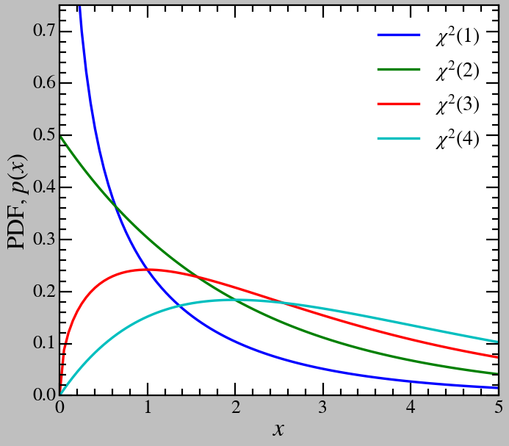


$$χ^{2}(x,k)$$
$Y=\sum_{i=1}^{k}{X_{i}^{2}}$
$X_{i}=\frac{{x_{i}−μ}_{i}}{σ_{i}}$
$p\left(x_{i}\right)≡N(x_{i}, μ_{i},σ_{i})$
$p\left(Y\right)=χ^{2}\left(Y,k\right)$
$\left\langle Y\right\rangle =k$
$σ^{2}=2k$

Slide 15
Statistical Uncertainty

Slide 16
Sources of Uncertainty
Limited resolution
Uncertainty from instruments
Counting error
Statistical spread of sample
Systematic errors and errors from physical phenomena (often calibratable)
…

Slide 17
Measuring Uncertainty & Error
Resolution (angular resolution of telescope)
Test on instrument (measure noise from sensor)
Poisson uncertainty in counting error
Standard deviation of sample as error
Monte Carlo methods
Physics models and simulations for calibration
Error propagation
…

Slide 18

Error propagation
Assume measured variables are gaussian distributed.
Error of $y=f(x_{1},x_{2},…,x_{n})$, assuming $x_{i}$ are not correlate
$$Δy=\sqrt{{\left(\frac{dy}{dx_{1}}\right)}^{2}Δx_{1}^{2}+{\left(\frac{dy}{dx_{2}}\right)}^{2}Δx_{2}^{2}+ …+{\left(\frac{dy}{dx_{n}}\right)}^{2}Δx_{n}^{2}}$$

Slide 19
Likelihood Statistics

Slide 20
Likelihood and Inference

Slide 21


Likelihood, Prior, and Posterior
Conditional probability: given a condition $B$, the probability of $A$ is $p\left(A | B\right)$.
Likelihood: The probability of the observed measurement given a prior $p\left(X | θ\right)$.
Prior: An assumption about the underlaying mechanism/physics of the system $θ$.
Posterior (probability): Given the observed measurement, what is the probability of the prior being correct $p\left(θ | X\right)$.
Example: Flip a “fair” coin 10 times, 3 heads, 7 tails. What is the prior and likelihood?.
$$p\left(θ | X\right)=\frac{p\left(X | θ\right)p\left(θ\right)}{p(X)}$$
$p\left(θ\right)$: the probability of the prior $θ$.
$p(X)$: can be understand as the probability of the measurement, but serve more as a normalizing factor $\int{dθ}p\left(θ | X\right)=1$.
$p\left(X\right)=\int{dθ}p\left(X | θ\right)p\left(θ\right)$.
Bayes’ theorem.

Slide 22
Maximum Likelihood Fitting

Slide 23
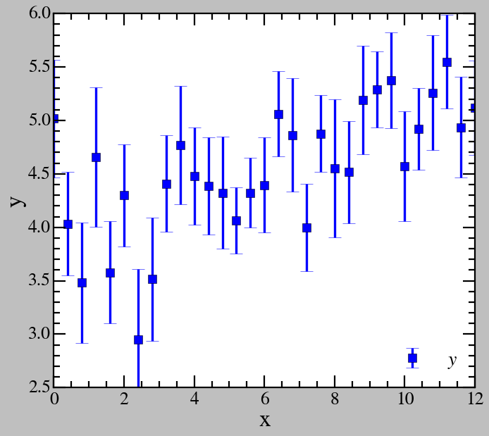
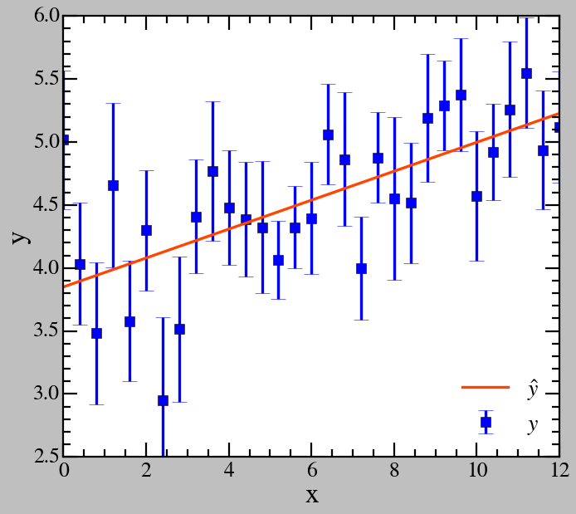


Least-square Fitting
Residual:
$χ^{2}\left(θ\right)=\sum_{i=1}^{N}{{\left(y_{i}−{\hat{y}}_{i}\left(θ\right)\right)}^{2}}$
${\hat{y}}_{i}\left(θ\right)=f\left(x_{i},θ\right)$.
Least-square fitting criterion: minimize the residual to find the ”best fit” parameters/prior $θ$.
With errors
$χ^{2}\left(θ\right)=\sum_{i=1}^{N}{\frac{{\left(y_{i}−{\hat{y}}_{i}\left(θ\right)\right)}^{2}}{σ_{i}^{2}}}$.
$a=0.115 \left(0.1\right); b=3.850 (4)$.
Prior: $\hat{y}=f\left(x,θ\right)=ax+b$
$$θ=(a,b)$$

Slide 24



Why Is the Residual Called $χ^{2}$?
Residual with errors
$χ^{2}\left(θ\right)=\sum_{i=1}^{N}{\frac{{\left(y_{i}−{\hat{y}}_{i}\left(θ\right)\right)}^{2}}{σ_{i}^{2}}}$.
Assuming noise is gaussian
$Y=\sum_{i=1}^{k}{{\left(\frac{{x_{i}−μ}_{i}}{σ_{i}}\right)}^{2}}$
$p\left(x_{i}\right)≡N(x_{i}, μ_{i},σ_{i})$
$p\left(Y\right)=χ^{2}\left(Y,k\right)$.
The residual follow a chi square distribution with $N^{∗}$ degrees of freedom ($N^{∗}= N – DOF\left(θ\right)$), which has the mean value of $N^{∗}$.
The closer the reduced chi square $\frac{χ^{2}\left(θ\right)}{N^{∗}}$ to 1, the more probable the residual

Slide 25



Least-square $≡$ Maximum Likelihood
Given the prior $f(x,θ)$ and the the measurement $\left\{\left(x_{i},y_{i}\right)\right\}$, what is the likelihood, assuming measurements have gaussian nature?
$$LH=\prod_{i=1}^{N}{N(y_{i},{\hat{y}}_{i}\left(θ\right),σ_{i})} \\ =\prod_{i=1}^{N}{\frac{1}{\sqrt{2πσ_{i}^{2}}}e^{−\frac{{\left(y_{i}−{\hat{y}}_{i}\left(θ\right)\right)}^{2}}{2σ_{i}^{2}}}}$$
$$LLH=\ln\left(LH\right) \\ =−\frac{1}{2}\sum_{i=1}^{N}{\frac{{\left(y_{i}−{\hat{y}}_{i}\left(θ\right)\right)}^{2}}{σ_{i}^{2}}+C} \\ =−\frac{1}{2}χ^{2}\left(θ\right)+C$$
Minimizing the residual/least-square error is equivalent to maximizing the likelihood.

Slide 26
Gradient Descend

Slide 27
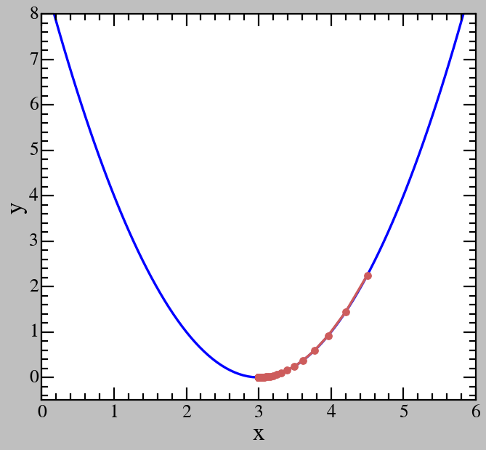
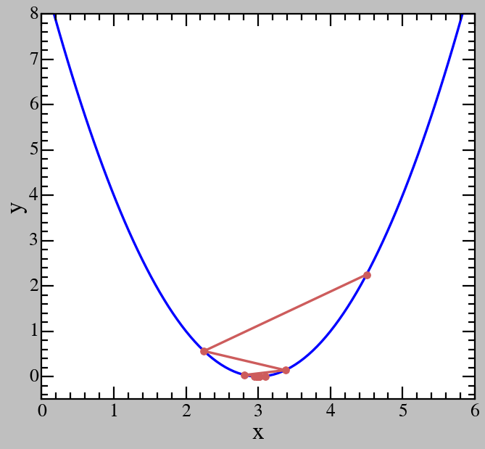
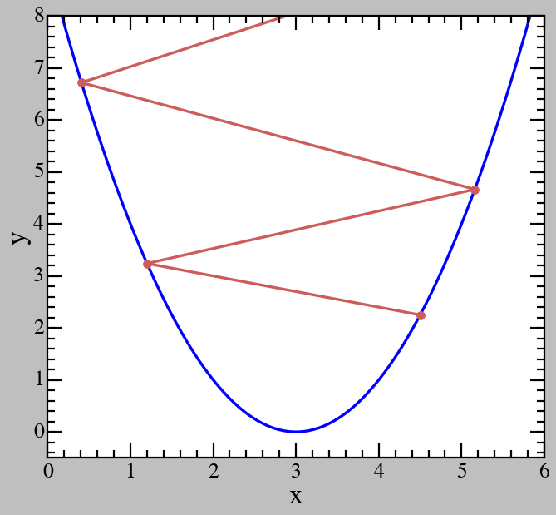

Physics Motivation
Problem: Given a function $y=f\left(x\right)$, find $x_{min}$ that minimize $y$.
A commonly used method: gradient descend.
Gradient descend: Take inspiration from physics, treat $y=f(x)$ similar to the gravitational potential $U(x)$, let the point naturally “fall down” to the lowest point.
Iterative step: $x_{k+1}=x_{k}−αf^{′}\left(x_{k}\right)$.
$α$: the learning rate.

Slide 28
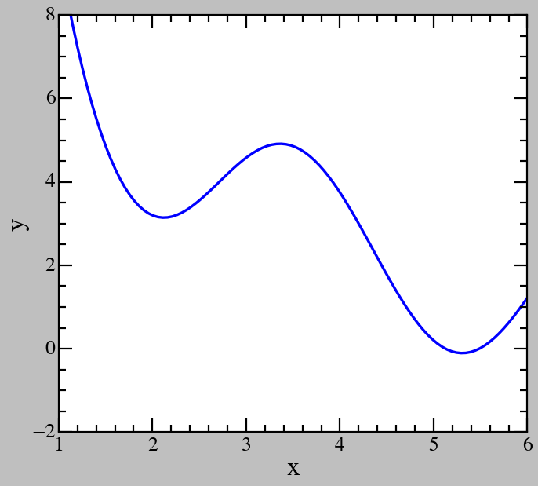
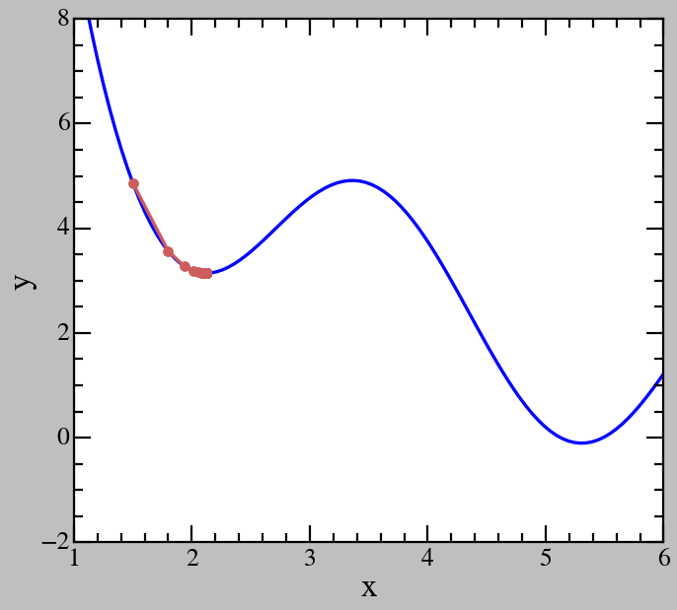
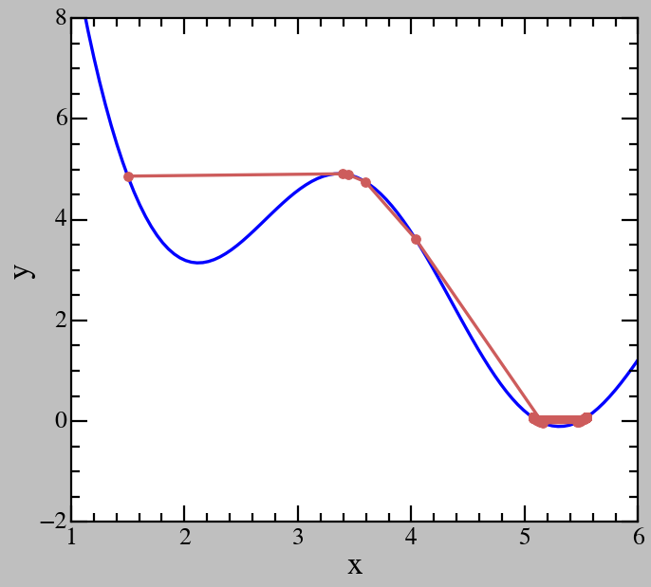

Local Minimum
Choosing a bad initial guess for the gradient descend can result in a local minimum.
A potential solution is increasing the learning rate $α$.
Another is to use more complicated algorithms, e.g. stochastic gradient descend,..

Slide 29
Uncertainty in Fitted Parameters

Slide 30
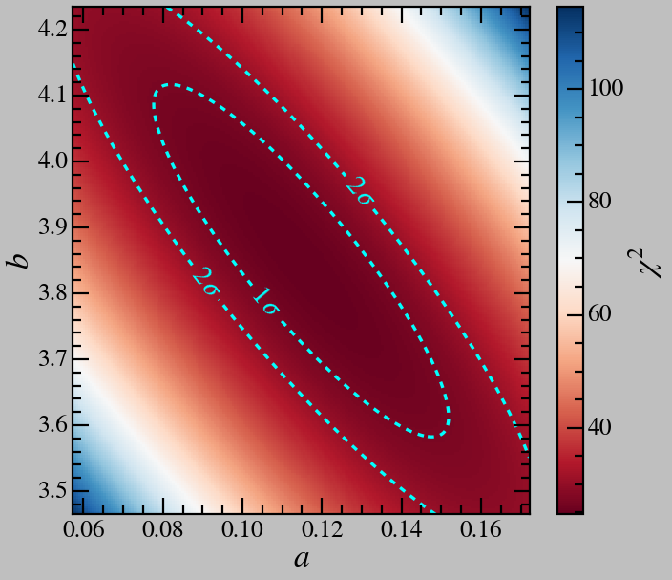
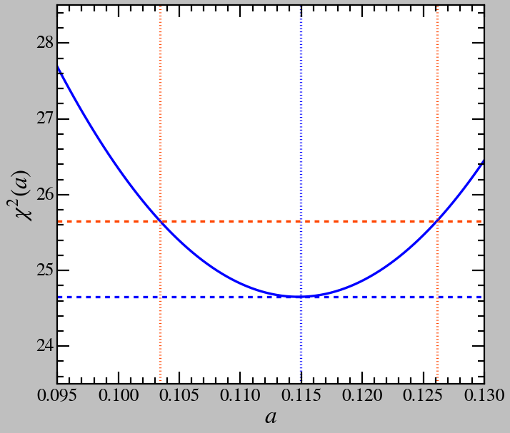


Uncertainty in Fitted Parameters
Reminder: The residual follow a $χ^{2}$ distribution with $N^{∗}=N−DOF(θ)$ DOFs ($N$ is the number of data point, $DOF\left(θ\right)$ is the number of parameters of the prior.
Fixing all except 1 fitting parameter $θ_{1}$ would reduce the chi square distribution to 1 DOF, $χ^{2}\left(θ\right)=χ^{2}\left(θ_{1},1\right)+C=\frac{{\left(θ_{1}−θ_{1,0}\right)}^{2}}{σ_{θ_{1}}^{2}}+C$.
Taking $θ_{1,0}$ to be the parameter with the highest likelihood, varying $θ_{1}$ by $σ_{θ_{1}}$ would vary $χ^{2}\left(θ\right)$ by 1 and vice versa.
More complicated treatment: Wilks’ theorem.
$$a=0.115±0.011$$

Slide 31
Cubic Spline Method

Slide 32
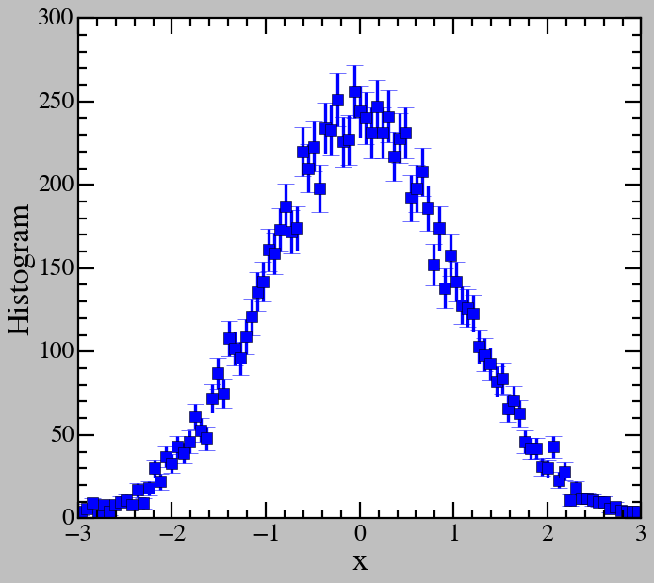

Histogram
Histogram: a type of plot showing how many points $x_{i}$ of a sample $\left\{x_{i}\right\}$ are within each of a set of range $\left\{\left[x_{low,i} ;x_{high,i}\right]\right\}$ called bins.
Histogram describe the distribution of a sample. A normalized histogram is basically a probability density function $p\left(x\right)$.
Example: sampling 10000 numbers from a normal/gaussian distribution.
Error bars are from (Poisson) counting errors.

Slide 33
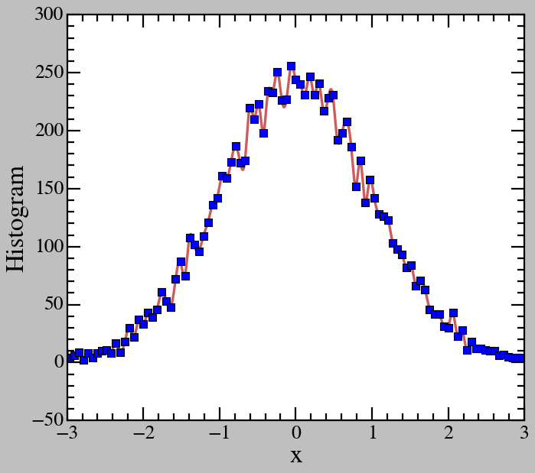
From Scatter Points to Function
Problem: what if we want to sample points from the distribution described by a histogram via the inversion sampling method, i.e. require a function form or interpolation of the CDF.
(Cubic) spline interpolation: every 5 points, fit a third order polynomial and ensuring continuity (i.e. requiring the function and first order derivative to be continuous).
Does not work very well when uncertainties are high or point are too dense, in which case, the fit function similar to a linear interpolation. Also does not work well with extrapolate, unless special treatments are applied (talk to me).

Slide 34
Benefits and (more) Limits
Derivative and integral are easier to perform
Spline fitting and interpolation reduce computing cost in many complicated functions, especially those that require integration (talk to me, my main research employ a lot of these techniques).
Spline fit always include original data points, so they may be overfitting.
Again, edge cases and extrapolation require special care.
Employing spline fit is more art than science!

Slide 35
Hypothesis Testing

Slide 36
Basis of Hypothesis Testing

Slide 37


Bayes’ Theorem
$$p\left(θ | X\right)=\frac{p\left(X | θ\right)p\left(θ\right)}{p(X)}$$
$p\left(θ\right)$: the probability of the prior $θ$
$p\left(X | θ\right)$: likelihood
$p\left(θ | X\right)$: posterior probability
$p(X)$: $\text{can} \text{be} \text{understand} \text{as} \text{the} \text{probability} \text{of} \text{the} \text{measurement}\text{, }\text{but} \text{serve} \text{more} \text{as} \text{a} \text{normalizing} \text{factor}$ $\int{dθ}p\left(θ | X\right)=1$; $p\left(X\right)=\int{dθ}p\left(X | θ\right)p\left(θ\right)$
Example 1: 2 coins, 1 fair 1 bias $(40/60)$, choose 1, flip 10 times, 3 heads 7 tails. What is the probability of the coin being fair?
Example 2: Monty Hall problem. 3 doors, 2 empty 1 with prize. You choose door 1. Door 2 is shown to be empty. Do you switch to door 3 or not?

Slide 38

p-value & Null Hypothesis
Null hypothesis $\left(H_{0}\right)$: the prior that there is nothing “special”, e.g. a constant function $y=b$, only background signal/noise..
Alternative hypothesis $\left(H_{1}\right)$: the prior that there is something “interesting”, e.g. signal from objects, new physics..
p-value: the cumulative likelihood that the null hypothesis can explain the observed data/measurement, i.e. the probability that fluctuation from the uncertainty in the null hypothesis/prior can result in the observed data/measurement.
A general standard is if p-value $<α=0.05$, the null hypothesis is most likely false.

Slide 39
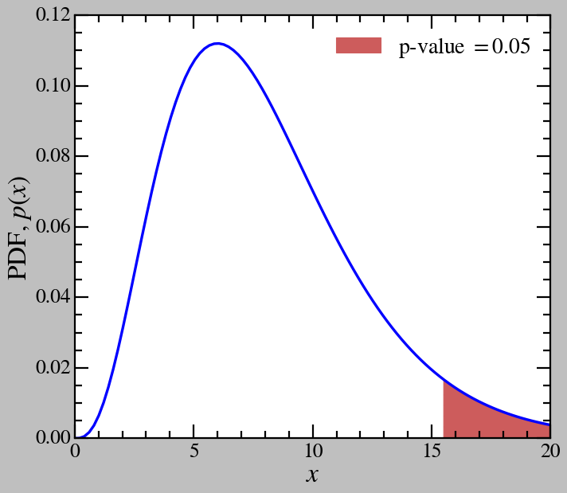
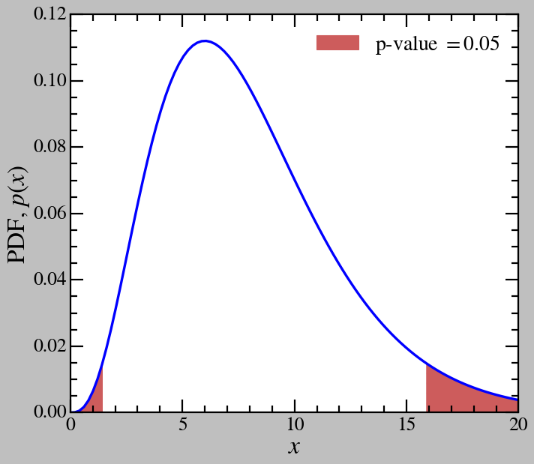
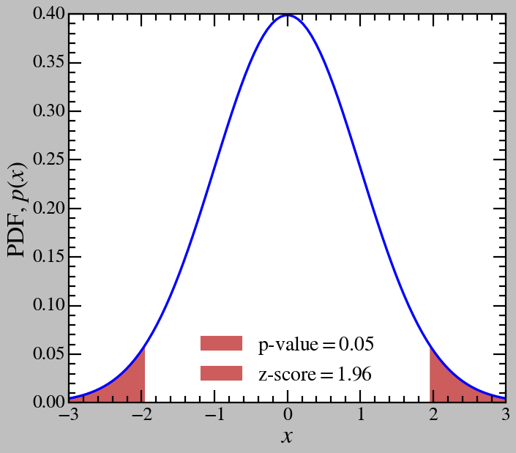
Visualizing p-value
p-value is often taken as the CDF of the distribution that governs the outcome of the measurement, i.e. the chi square distribution. This is the single-tail p-value. However, beware of high p-value in the chi square distribution!
The double-tail p-value takes into account both ends of the distribution, i.e. all regions with the probability distribution function less or equal than that of the observed likelihood. This is more trust worthy in most case, exceptions include the chi square distribution.
p-value can be translate to z-score, which describe, in the context that the distribution in question is mapped to a gaussian/normal distribution, how many standard deviations from the peak probability is the observed likelihood.

Slide 40
Bootstrapping

Slide 41
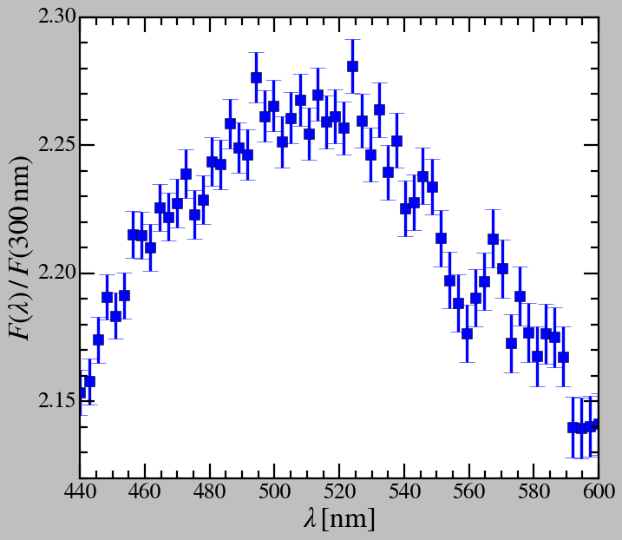
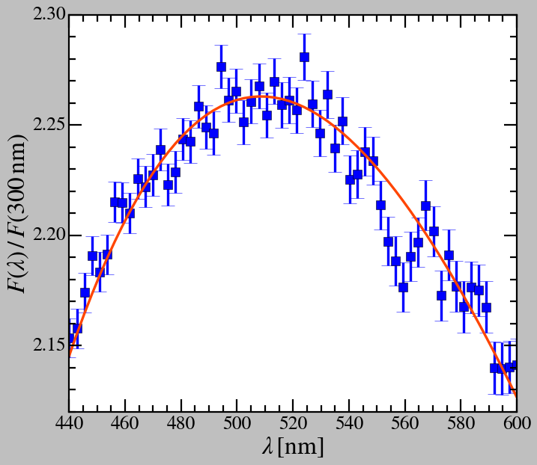
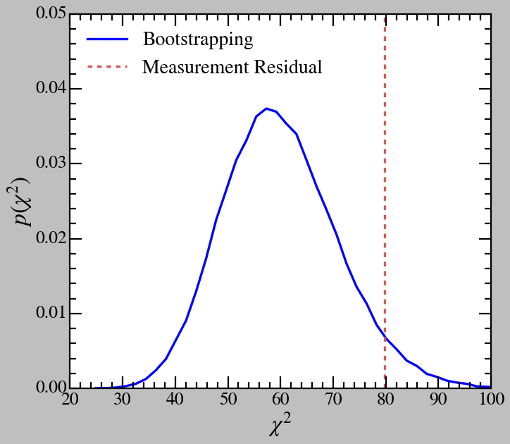
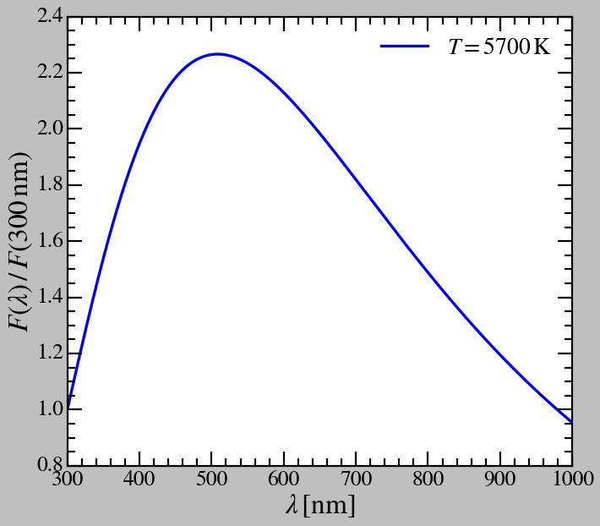

In the Case of Complicated Null Hypothesis
Example: Absorption line with a black-body background
$$F\left(λ,T\right)=\frac{2hc^{2}}{λ^{5}}\frac{1}{e^{\frac{hc/λ}{k_{B}T}}−1}$$
Null hypothesis: only black-body background. Let’s try fitting the background.
Bootstrapping: a Monte Carlo method, from the null hypothesis, try to sample/simulate the measurement a large number of time, and inspect the distribution of the resulting configurations.
In this case, let’s look at the distribution of the residual $χ^{2}$. Different hypothesis tests have different criteria.

Slide 42
Likelihood-ratio Testing

Slide 43
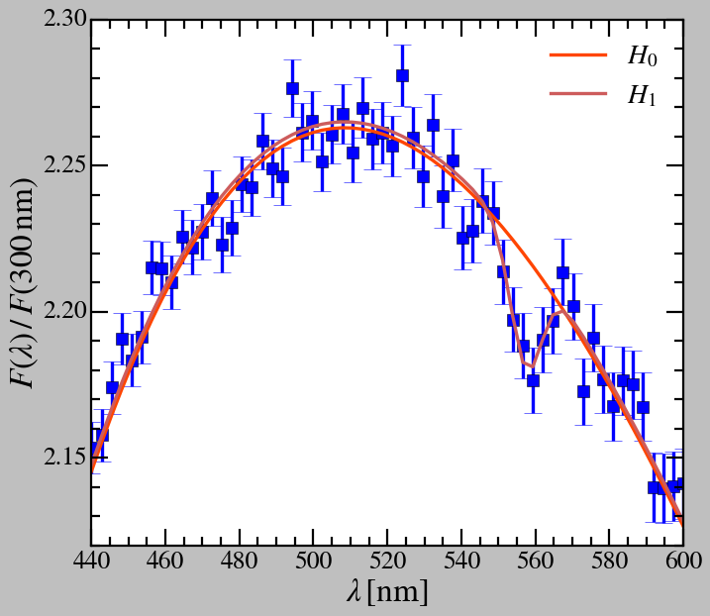

Null Hypothesis v.s. Alternative Hypothesis
Example: Absorption line with a black-body background
Null hypothesis $H_{0}$: only black-body background.
Alternative hypothesis $H_{1}$: black-body background with an absorption feature, modeled with a gaussian function form: $I\left(λ\right)=I_{BB}\left(λ\right)−I_{ap}.N\left(λ,λ_{ap}, σ_{ap}\right)$.
Reminder: $χ^{2}\left(θ\right)=−2\ln\left(p\left(X | θ\right)\right)+C$
$\frac{p\left(X | H_{0}\right)}{p\left(X | H_{1}\right)}=\exp\left(−\frac{χ^{2}\left(H_{0}\right)−χ^{2}\left(H_{1}\right)}{2}\right)$

Slide 44

Null Hypothesis v.s. Alternative Hypothesis
From Wilks’ theorem: $−2\ln\left(Λ\right)=−2\ln\left(\frac{p\left(X | H_{0}\right)}{p\left(X | H_{1}\right)}\right)=χ^{2}\left(H_{0}\right)−χ^{2}\left(H_{1}\right)$ follows a chi square distribution with $ΔN=N_{1}−N_{0}$ DOFs ($N_{1}$ and $N_{0}$ are the number of free parameters in $H_{1}$ and $H_{0}$, respectively) under the null hypothesis.
$−2\ln\left(Λ\right)$ represents the probability that under the null hypothesis, the observation/measurement can happen.
p-value can be quoted!
In the example: $ΔN=3$; $−2\ln\left(Λ\right)=33.23$.
Resulting in: p-value $=2.88×{10}^{−7}$; z-score $5.13$
5-sigma! Discovery!
(Evidence if only 3-sigma)

Slide 45
Main Takeaways

Slide 46
1. Sample/distribution Analysis
1.a. Mean, STD, Median, MAD
1.b. Histogram
2. Uncertainty and Error Analysis
2.a. Dealing with Uncertainty
2.b. Error Propagation
3. Fitting and Parameter Uncertainty
3.a. Maximum Likelihood Fitting
3.b. Parameter Uncertainty
4. Likelihood and Hypothesis Testing
4.a. Bayes’ theorem
4.b. Bootstrapping
4.c. Likelihood-ratio

